Slide 1
Hospital Management System
CREATED BY:
PRANAV GANDHI : EBEONFWL617696
GAURAV PUND : EBEON0622113439
VISHAL JAPKAR :
ANVESH GUDDETI : EBEON0622611119
Guided by,
Vardharajan Sir

Slide 2
Introduction
The project Hospital Management System includes registration of patients, storing their details into the system, and also computerized billing in the pharmacy, and labs. The software has the facility to give a unique id for every patient and stores the details of every patient automatically. The Hospital Management System can be accessed by different users using a username and password. It is accessible by an administrator, receptionist, doctor and a pharmacist. Only the admin can register users into the database. The data can be retrieved easily. The interface is very user-friendly. The data is well protected for personal use and makes the data processing very fast.
Hospital Management System is powerful, flexible, and easy to use and is designed and developed to deliver real conceivable benefits to hospitals. Hospital Management System is designed for multispecialty hospitals, to cover a wide range of hospital administration and management processes. It is an integrated end-to-end Hospital Management System that provides relevant information across the hospital to support effective decision making for patient care, hospital administration in a seamless flow. Hospital Management System enables you to develop your organization and improve its effectiveness and quality of work.

Slide 3
Hospital Management System Modules List :
Admin
Doctor
Pharmacist
Receptionist

Slide 4
Hospital Management System :
Admin
The super user, admin class represents complete authority over the system an admin can
  Admin can register Doctors, Pharmacists and Receptionists
  View the number of users.
  Admin can update his own profile.
  Admin can update and delete the users.
  Admin can view his dashboard which displays all the data entered and generated by the system.
  Admin can see bill report for particular patient.

Slide 5
Hospital Management System :
Doctor
  Can view his/her Patients and their appointments.
  Can update Patient treatment status.
  Can assign medicines to Patients based on their diagnosis
  Adds the fee amount for that particular patient.

Slide 6
Hospital Management System :
Pharmacist
  Can add Medicines.
  Can add Distributors.
  Can add Medicine Company.

Slide 7
Hospital Management System :
Receptionist
Can register Patients.
Can book appointments for patients.
Can view Appointment status and Treatment status for patients.
Can generate and download patient Bill.

Slide 8
Technologies Used
Backend :Spring Boot, Spring MVC, Java , Servlet
Frontend :JSP , HTML , CSS , Java Script
Styling : Bootstrap
Project Management : Maven
Database :MYSQL
Server : Embedded Tomcat Server

Slide 9
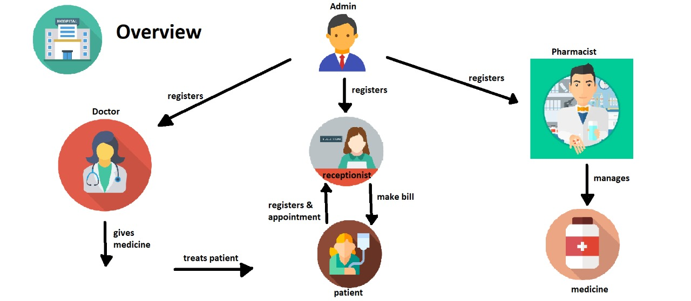
CONTROL FLOW DIAGRAM

Slide 10
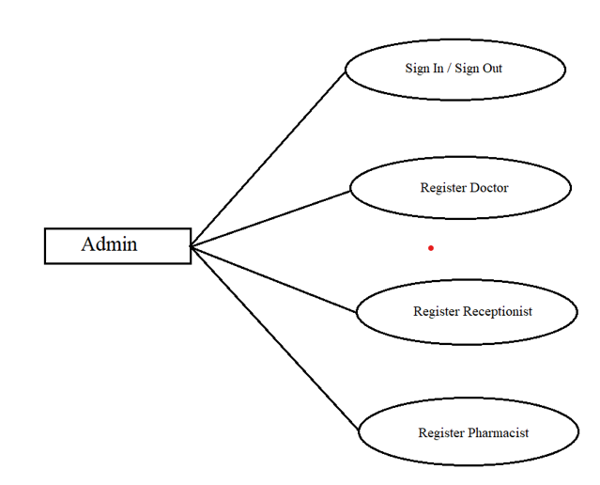
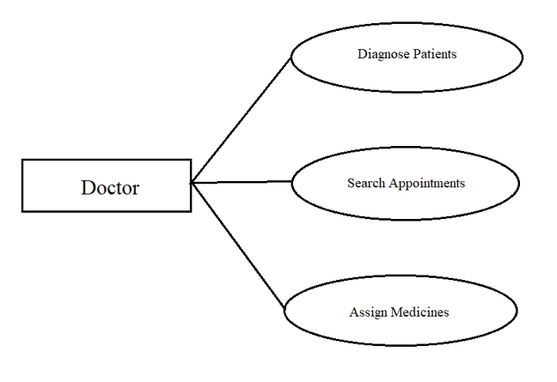
USE CASE DIAGRAM

Slide 11
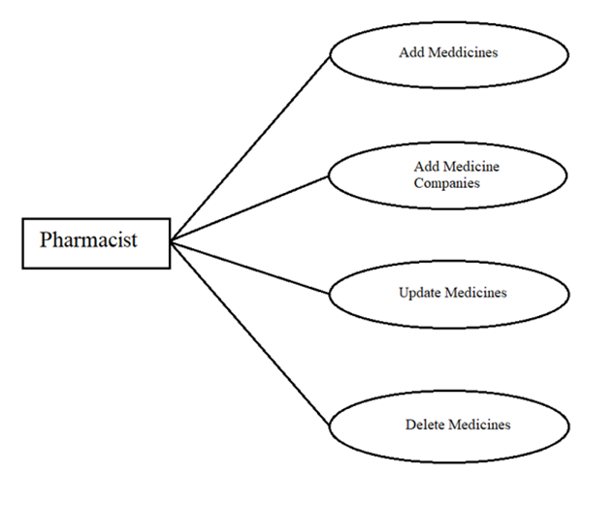
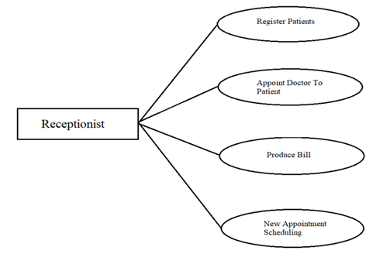
USE CASE DIAGRAM

Slide 12
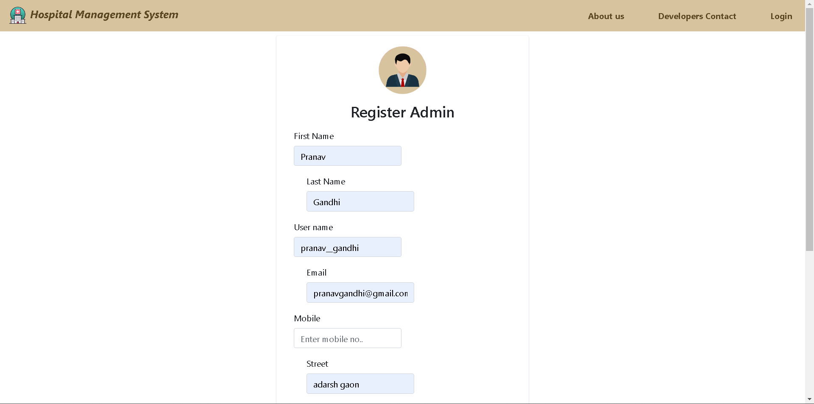
Interface:

Slide 13
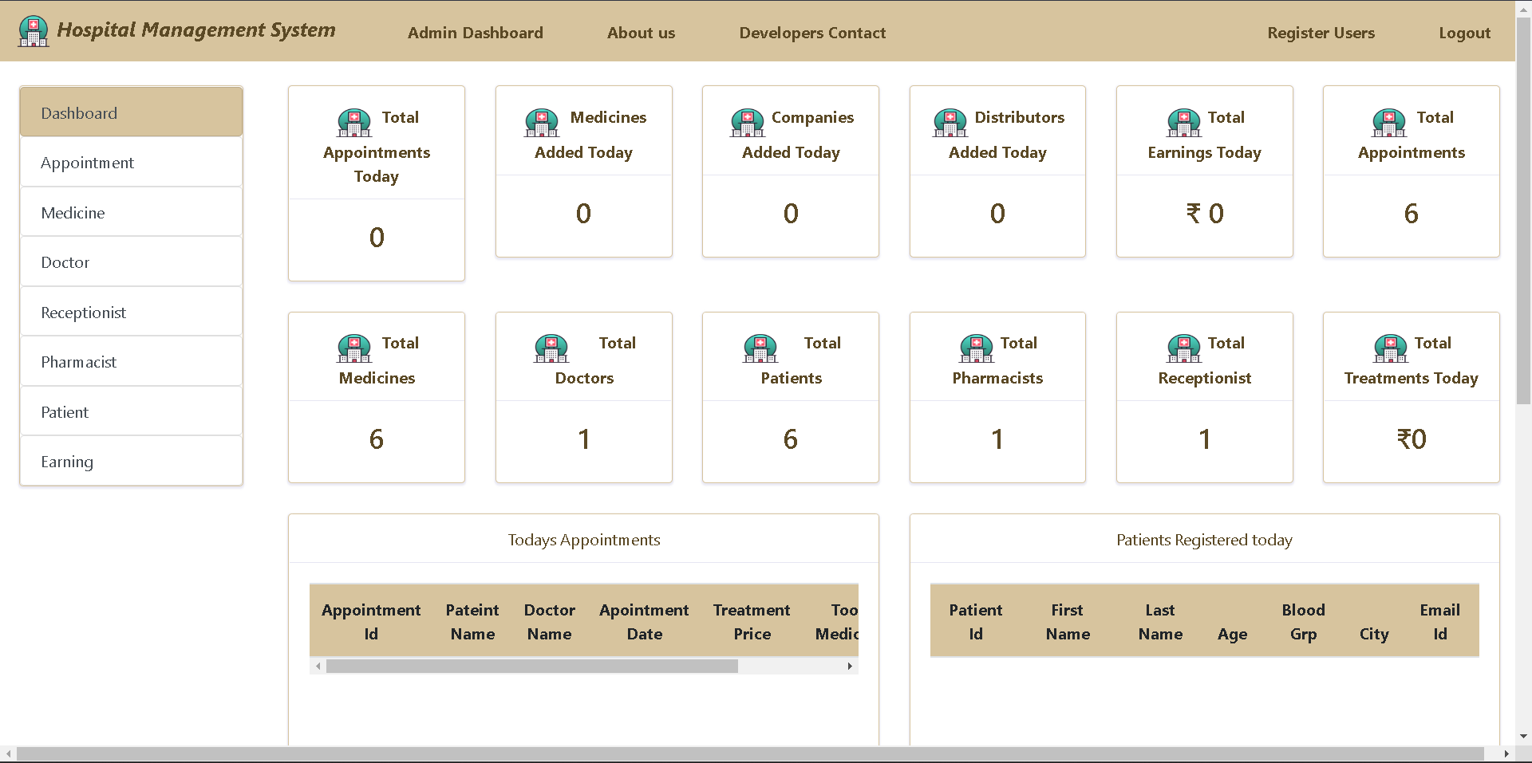

Slide 14
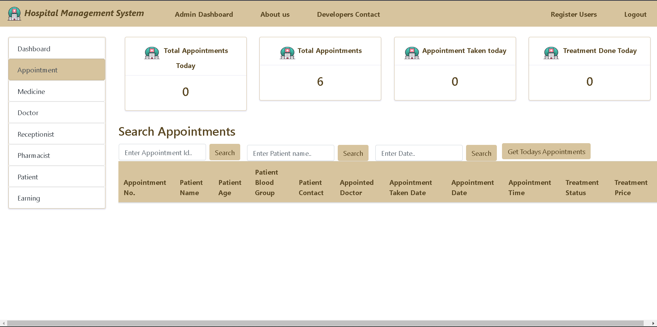

Slide 15
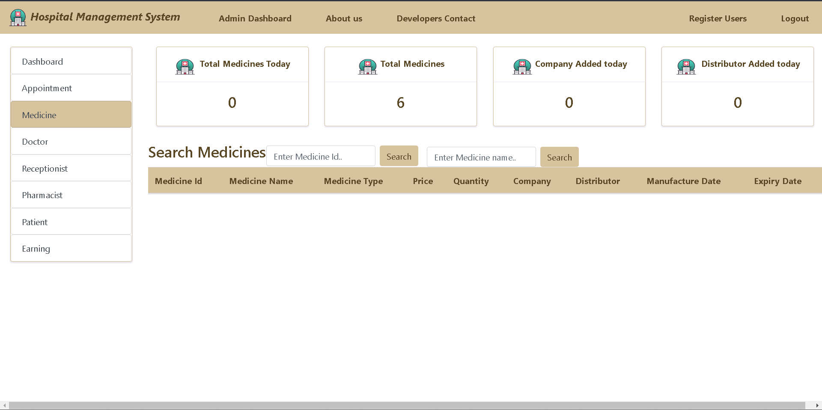

Slide 16
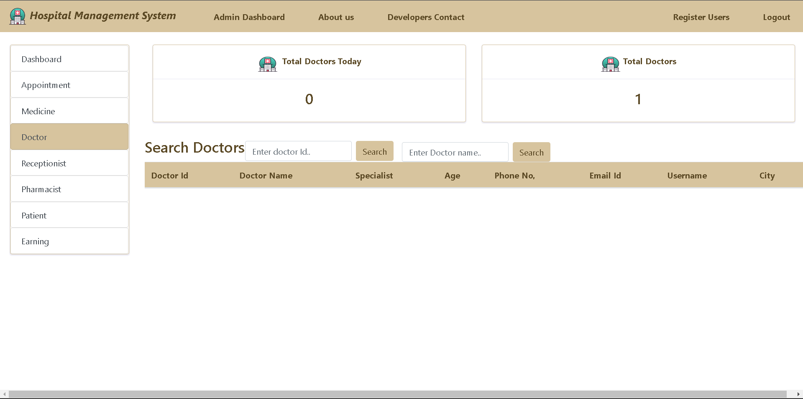

Slide 17
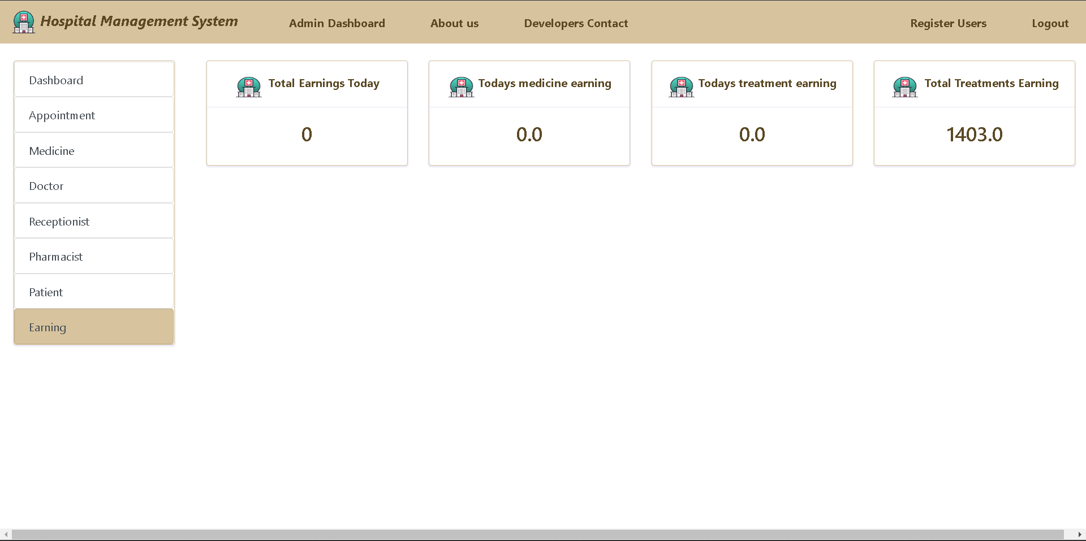

Slide 18
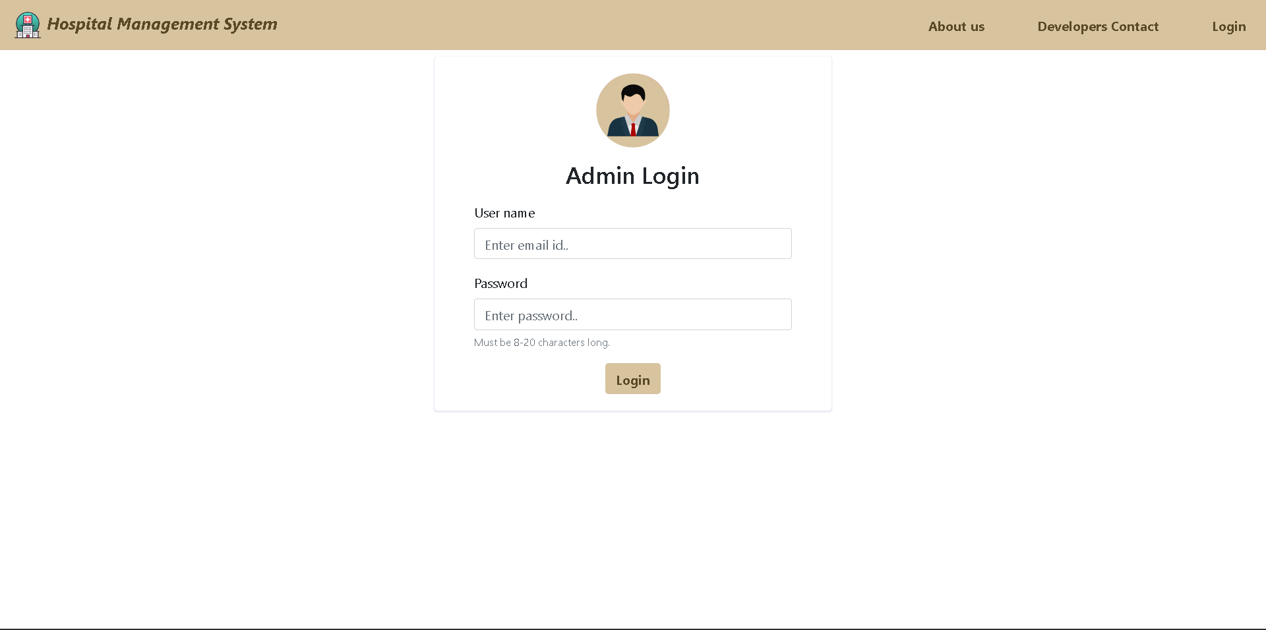

Slide 19


Slide 20
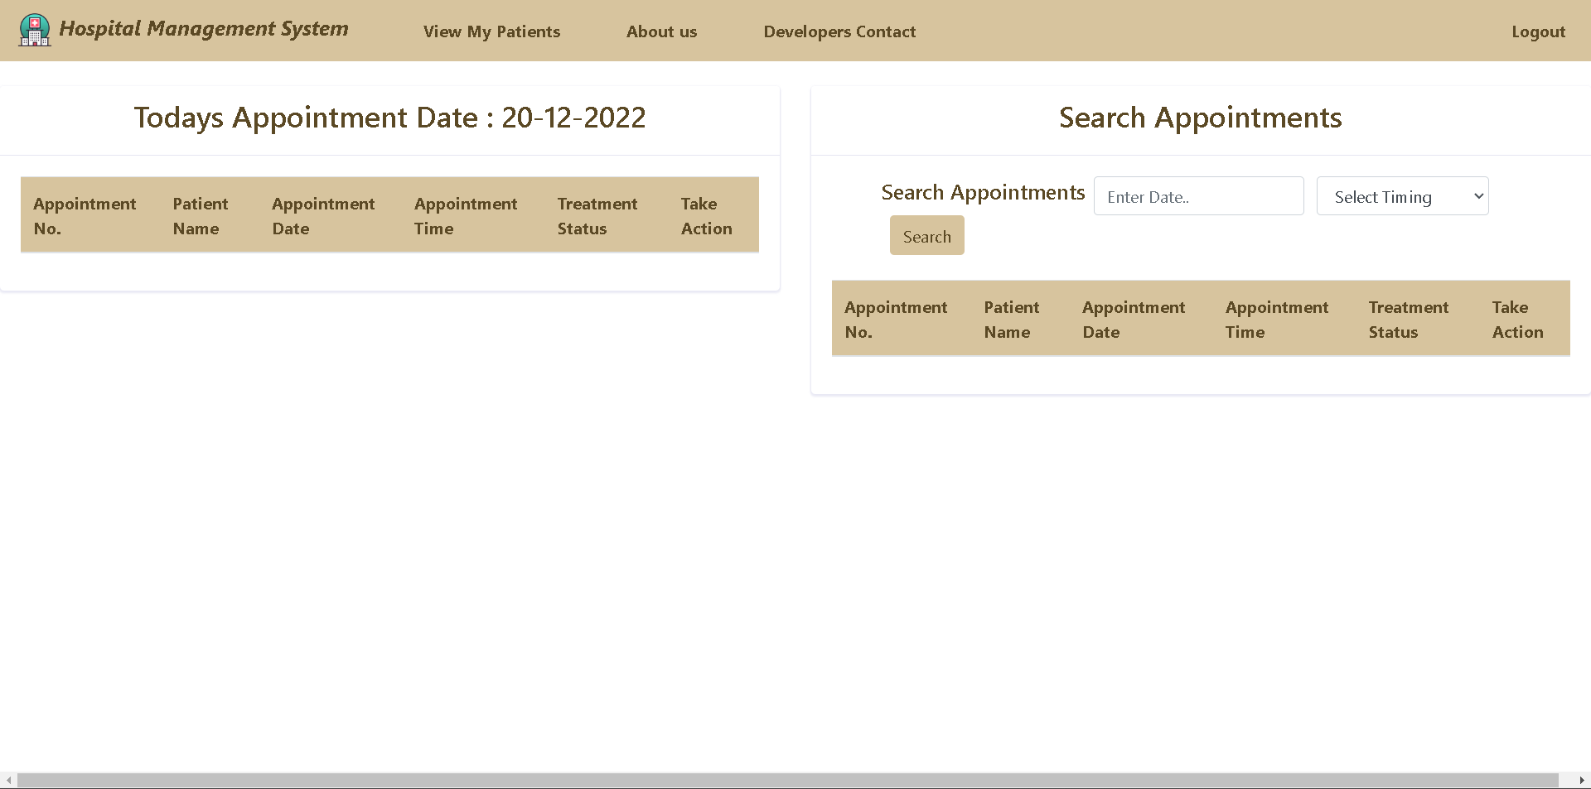

Slide 21


Slide 22


Slide 23
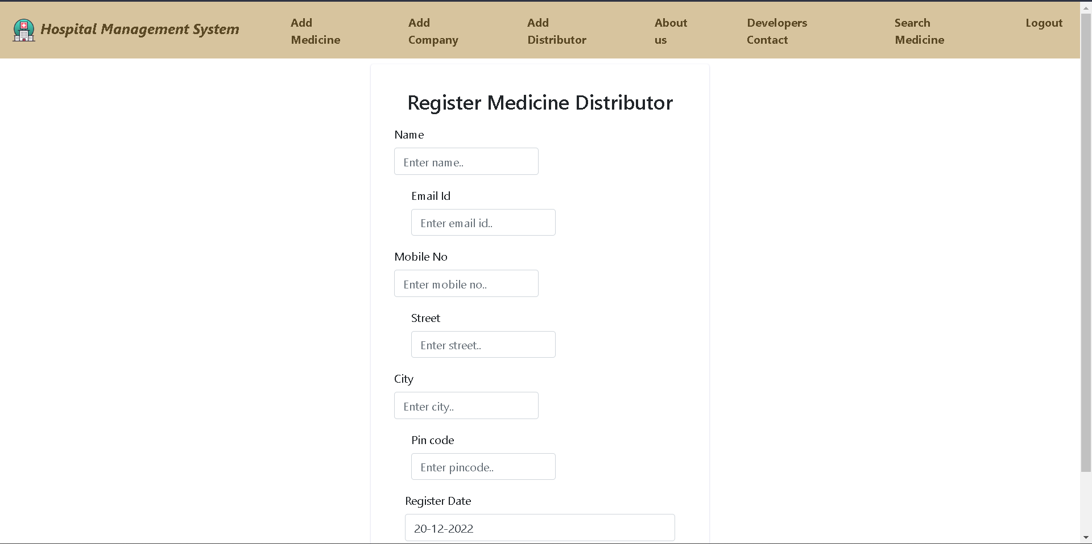

Slide 24
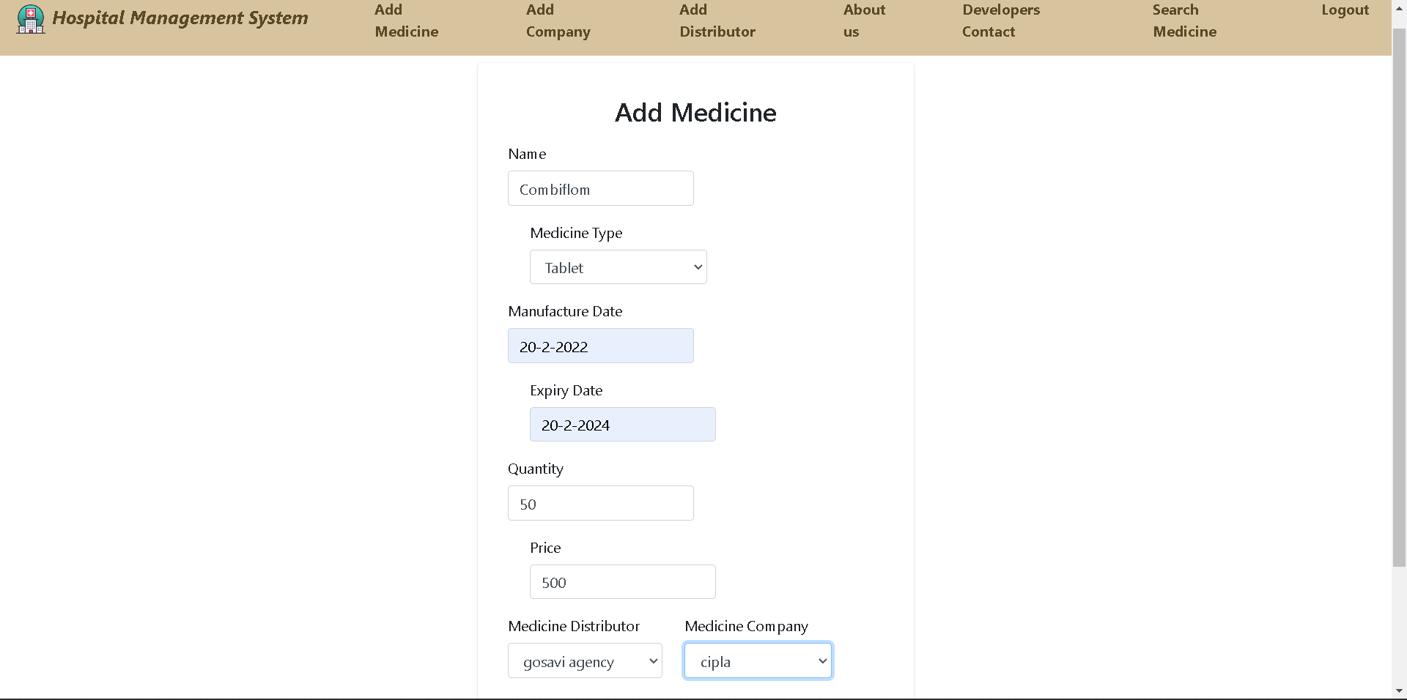

Slide 25
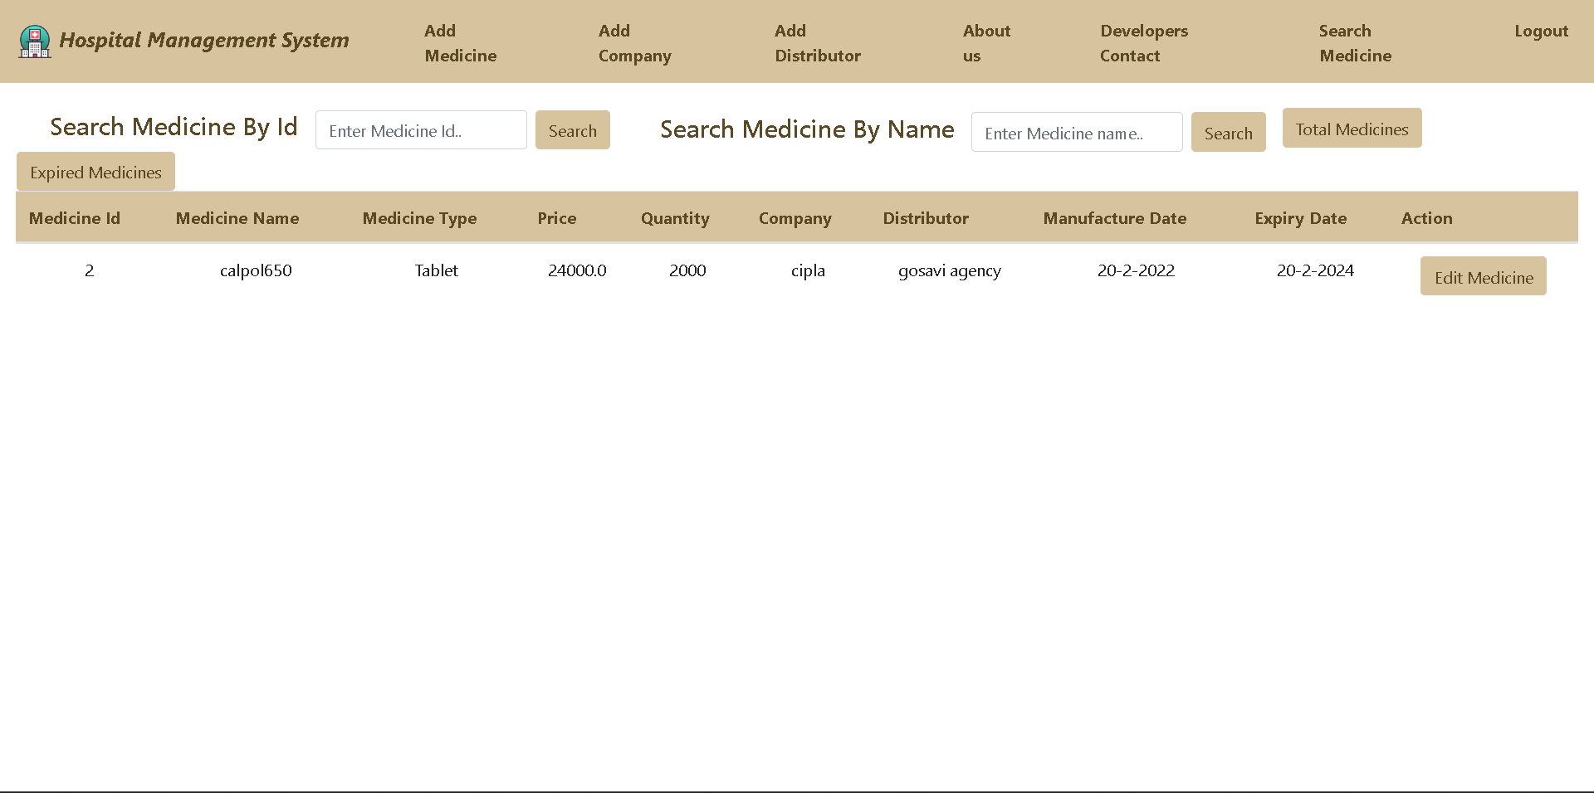

Slide 26
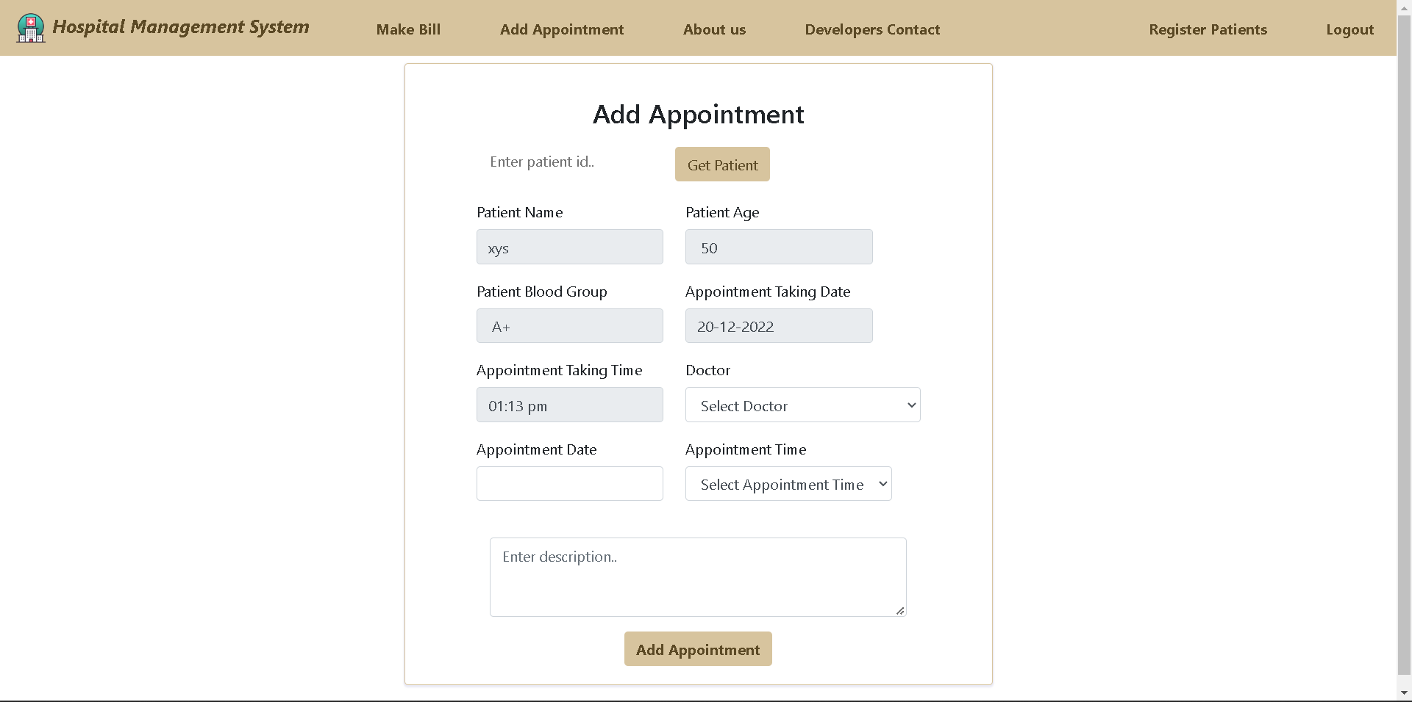

Slide 27
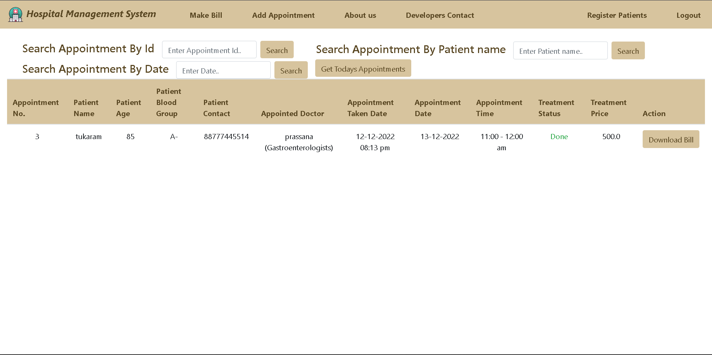

Slide 28
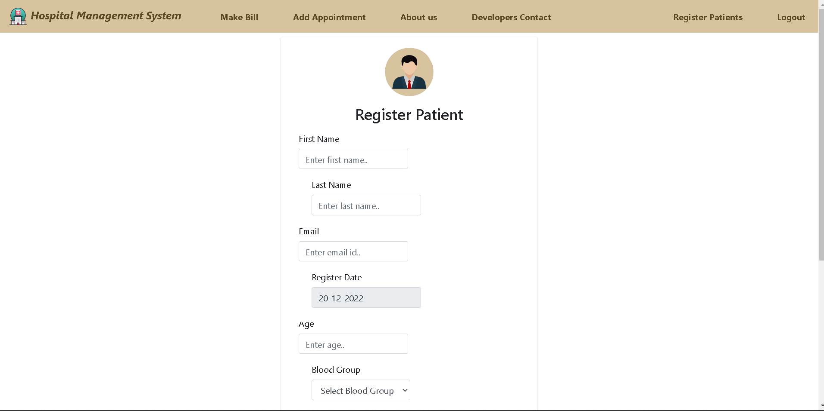

Slide 29
Challenging issues
As i was a team leader key challenge for me to identify in which technology my teammate is good at and assign that teammate the task he will enjoy doing.
As I was doing admin coding for admin module I was confused what features to add but after adding some basic features I got the idea what more things I can add to my modules.

Slide 30
Future enhancement
Future Scope of this project is betterment of the software.
Adding the functionality for maintaining the records of on-going surgeries, or operations and X-Ray, MRI facilities.
A feature of 'blood bank' for the patients can be added to the system.
The system can also be made directly accessible to the patients in the future for them to view their on-going treatments, medicines registered for them and many more..

Slide 31
Conclusion
This software reduces the amount of manual data entry and gives greater efficiency. The User Interface of it is very friendly and can be easily used by anyone. It also decreases the amount of time taken to write details .Well-tuned hospital management workflow involves lots of important decisions that should be made in the most efficient and quick way. Nowadays it is hard to implement it without the distinct hospital management system. In this app, we’ll explore what is HMS software, what functions it performs and how it helps the healthcare industry be more effective.

